Slide 1
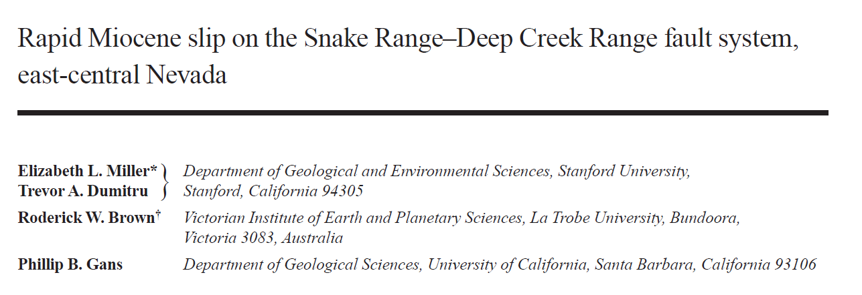
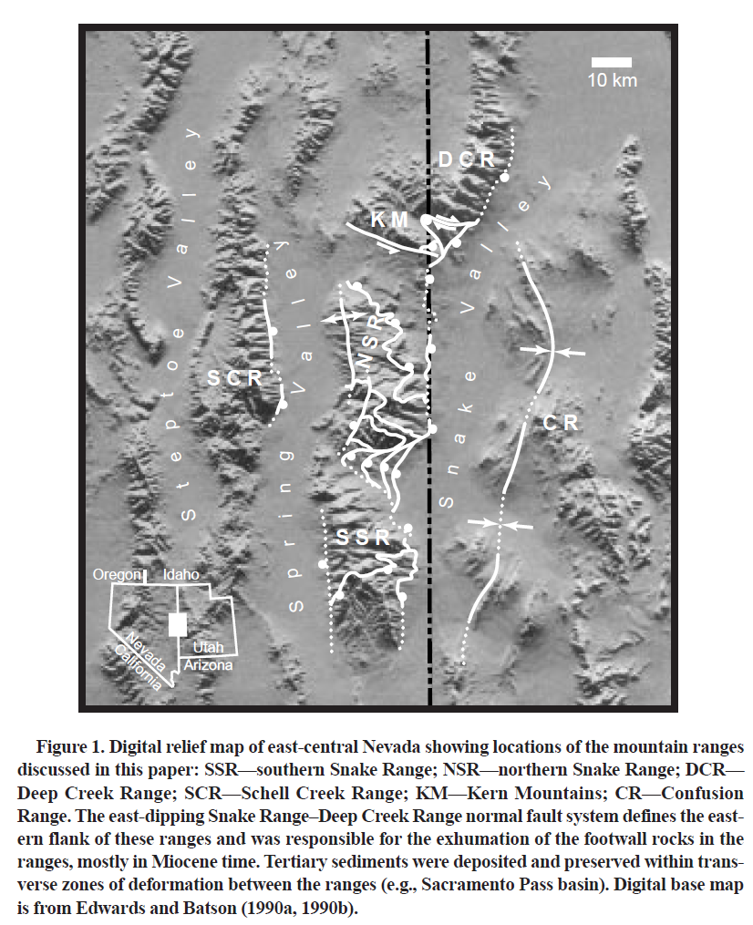
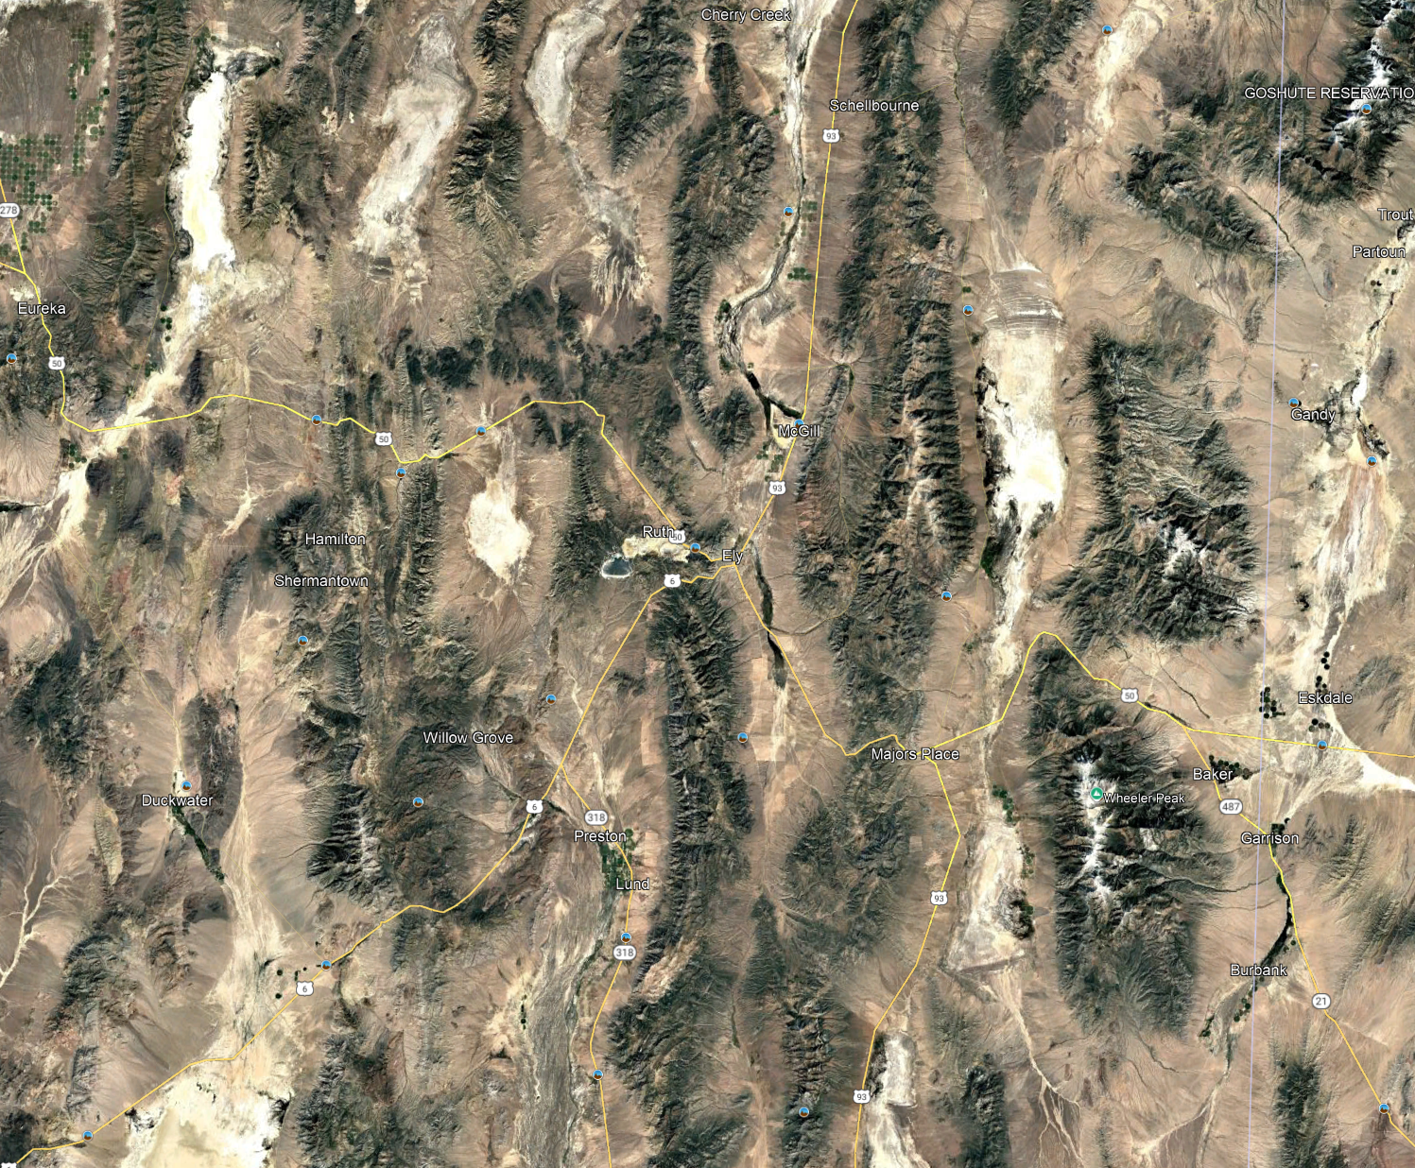
“The Snake Range is a classic example of a normal-faulted bounded metamorphic core complex developed as a consequence of Tertiary extension of the Basin and Range province”
This study is the result of significant time spent geologic mapping in the range
SR

Slide 2
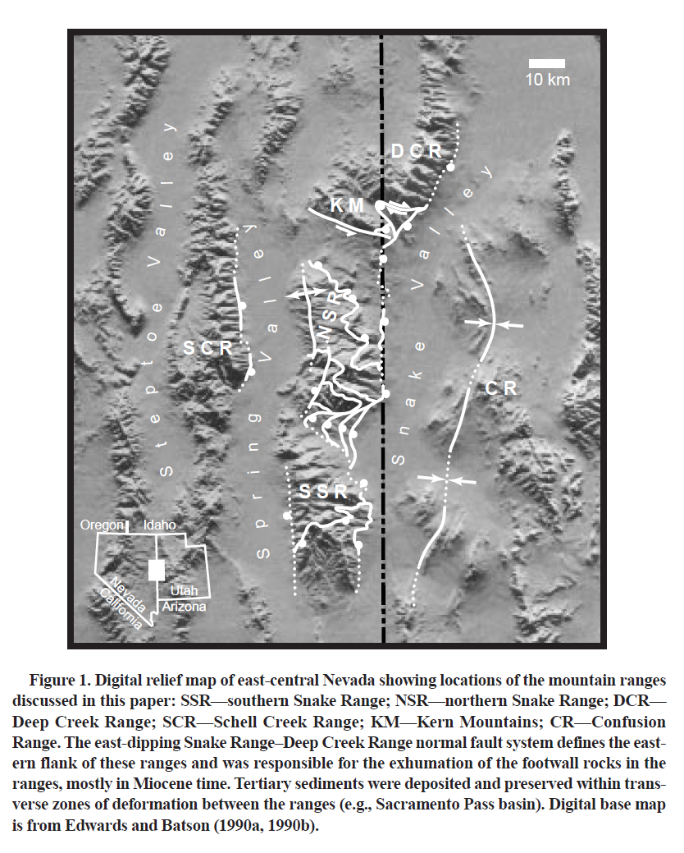
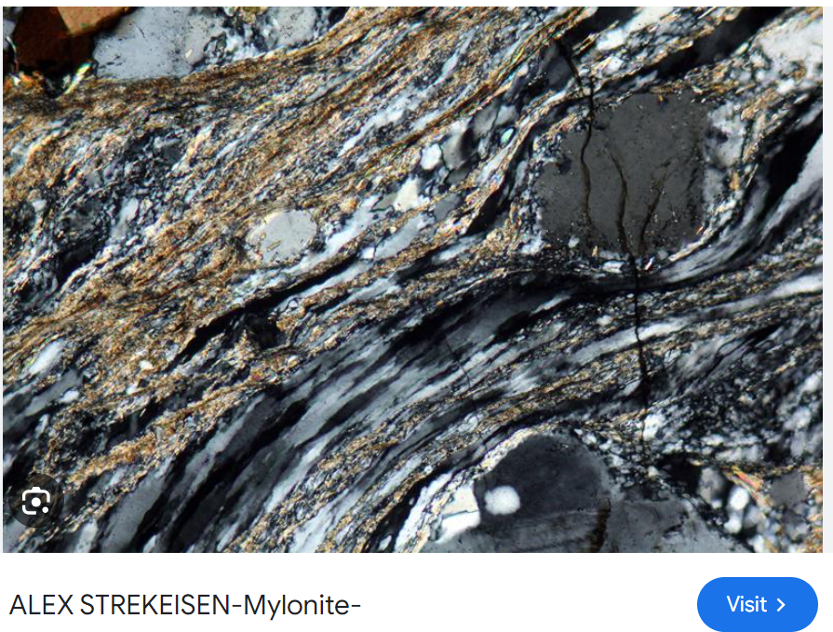
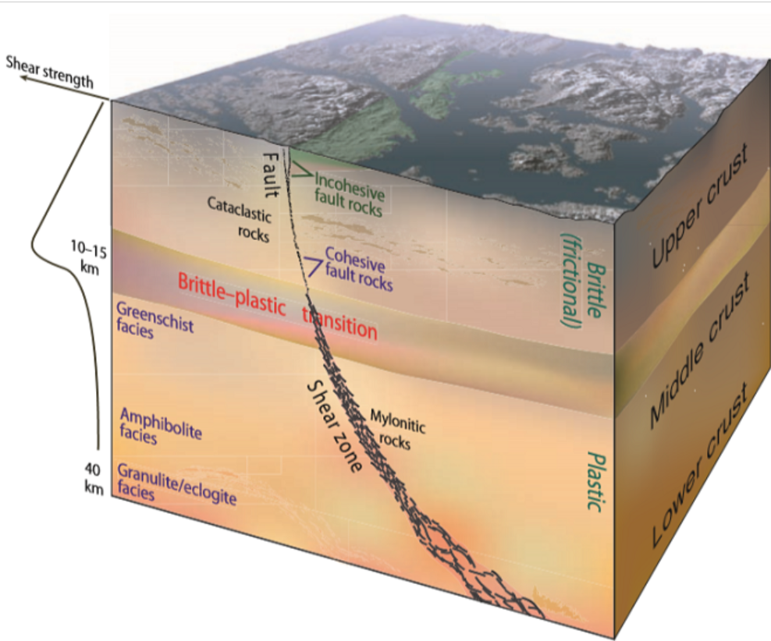
Broad Geology Overview
Precambrian to Triassic shelf rocks
Folding, metamorphism, and plutonism in the Mesozoic
Ore deposits related to the Mesozoic plutons include tungsten skarns (~5-10km paleodepths) and mesothermal gold-bearing veins (~2-5km paleodepths)
Plutonism and metamorphism in the Eocene to Oligocene
The Tertiary Snake Range-Deep Creek Range fault system accommodated extension.
150km long
Movement in the Eocene and then the Oligocene
Precambrian-Cambrian rocks and mylonites in the footwall and upper Paleozoic rocks in the hanging wall
Highest extension in the northern Snake Range
Multiple historic interpretations from geologists. Some include:
Mesozoic thrust fault (1960)
Extension reaching the brittle-ductile transition zone (1983)
Low-angle faults in the upper crust (1984)
Mylonites are intensely sheared rocks that exhibit ductile fabrics and recrystallized grains.
Interpreted to form below the brittle ductile transition

Slide 3
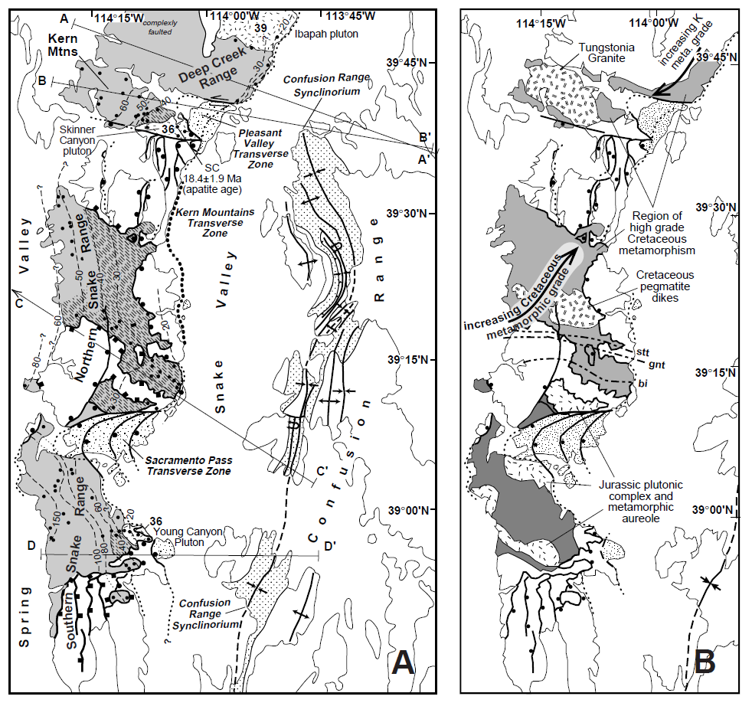
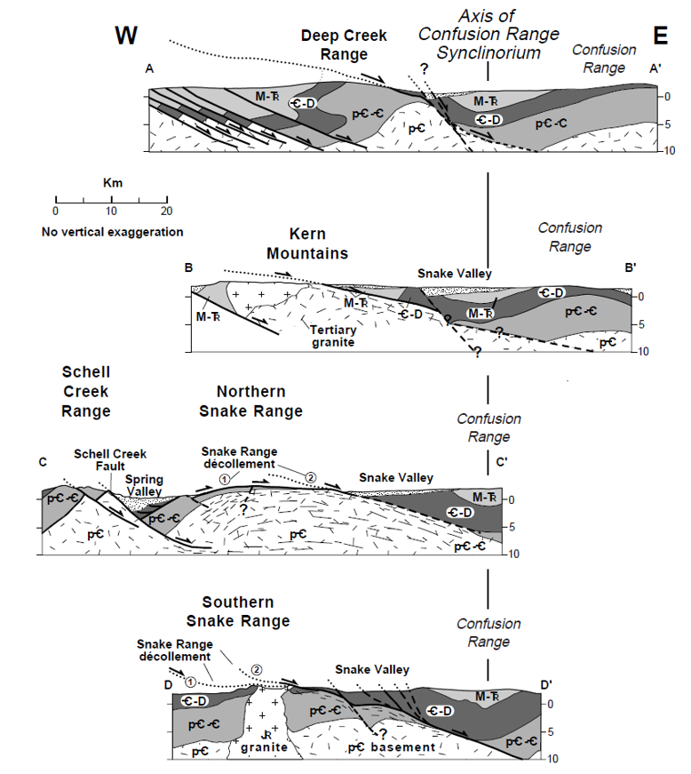
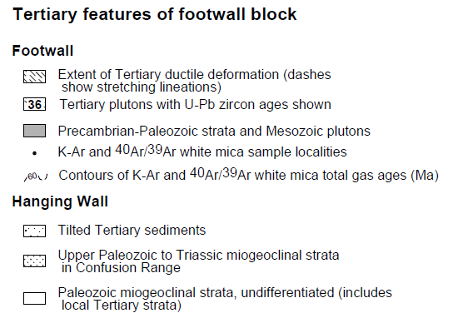
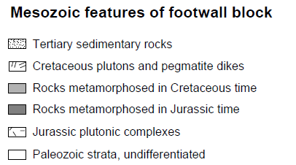
Detailed Overview
Key General Points:
Ductile deformation, like mylonite, overprints Mesozoic plutons and related metamorphism in the northern Snake Range (where extension is the highest) and Kern Mountains
A sequence of normal fault arrays accommodate extension and tilting
A bulge in the Confusion Range synclinorium is interpreted to be a result of being opposite the area of greatest extension
Transverse zones of deformation (WNW to ENE) associated with oblique faults and preserved tilted Tertiary sediments
Key Continuity Points:
The authors argue that the similar plutonic, metamorphic, and depositional histories suggest a coherent shared history from the Snake to Deep Creek Ranges
Intra-formation marker beds and individual formations provide continuity between the north and south Snake Range
Rocks can’t be traced across the Pleasant Valley transverse zone
Plutons and related metamorphism in the Kern Mountains into the Deep Creek Range

Slide 4
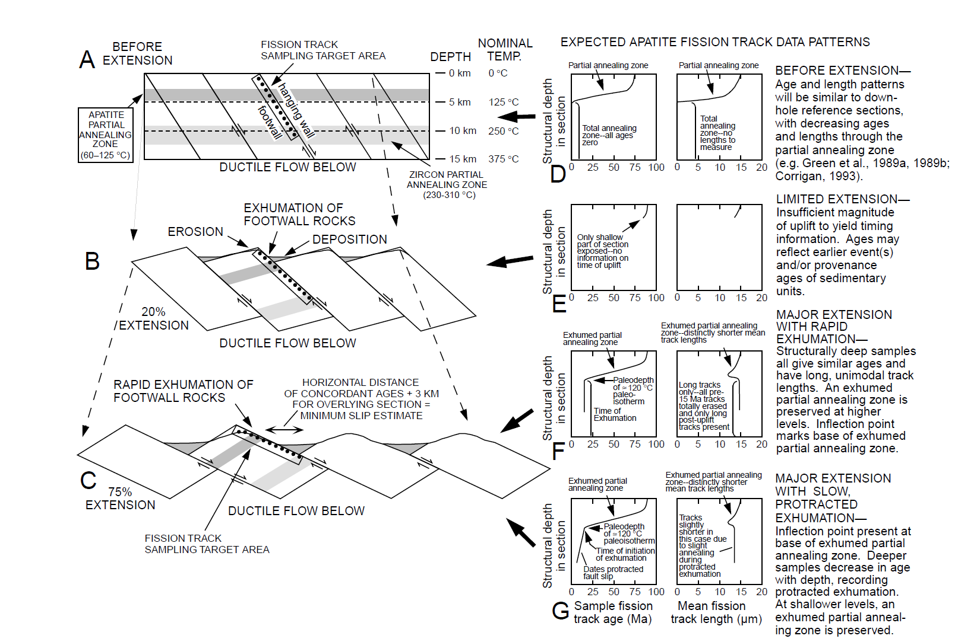
Apatite Fission Track: Overview
Youngest age (0)=Just above or below annealing zone=no tracks
Oldest age=farthest away from annealing zone=longest track
Limited extension results in a small and incomplete data profile (limited exposure)
Major extension is marked by the exhumation of the partially annealed zone (inflection point).
The partially annealed zone retains fission tracks with lower mean lengths
By assuming the geotherm, the base of the partially annealing zone would be ~4km helping bracket extension rates.
Date at inflection point marks the onset of extension (above the inflection point can be considered typical conditions)
Differences between rapid and slow exhumation
Rapid exhumation results in deeper rocks below the annealing zone to be rapidly brought up to the surface resulting in slightly higher mean lengths than slower exhumation.
Rapid exhumation results in vertical age profile after inflection point while slower exhumation results in gradual age decrease
The spontaneous fission of U238 produces two nuclides that travel ~7um in opposite directions producing ~15um fission tracks (Dickin, 2018). The track lengths are reduced in size when produced in the annealing zone

Slide 5
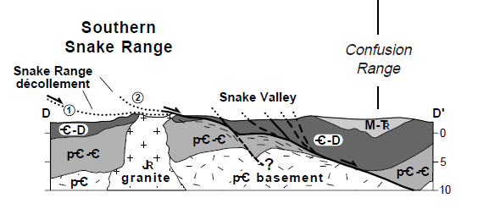
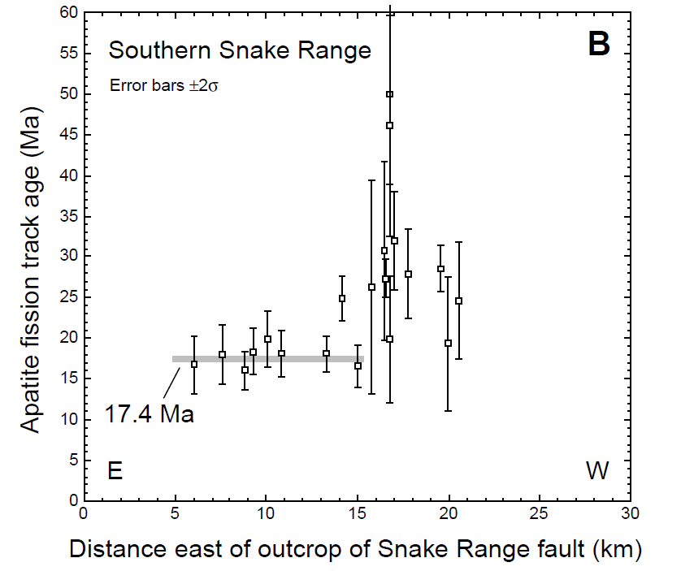
Southern Snake Range: Apatite
21 apatite samples from this area
Samples from the eastern and central part cluster around 17 Ma and have long mean track lengths indicate rapid cooling and exhumation around this time
Samples from the western part of the range are distinctly older, reaching ages up to 50 Ma, with variable but shorter track lengths.
Using the spatial distribution of apatite ages, they calculate 15 km of extension
12km from the horizontal distribution of apatite ages at 17 Ma
An additional 3km to account for the overlying exhumed partially annealed and higher levels
Since the apatite track lengths are long and date to 17 Ma, displacement along Basin-and-Range faults since that time could not be more than 2km (the distance to the partially-annealed zone)

Slide 6
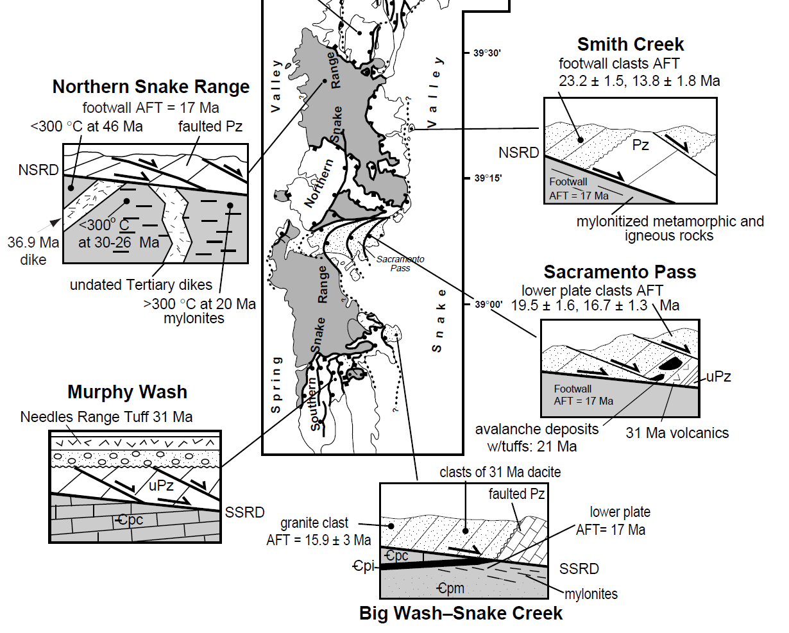
Southern Snake Range: Evidence for Two Events
In the west to central southern Snake Range, the Needles Range Tuff (31Ma) mantles faults that merge into the master decollement suggesting an older extension event

Slide 7
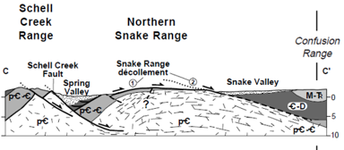
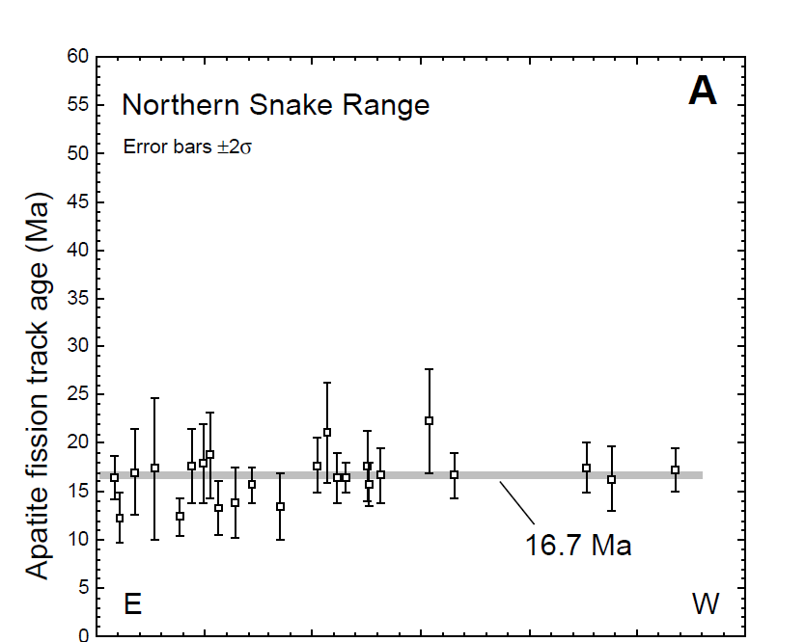
Northern Snake Range
In this area, bedding dips gently and is parallel to the underlying low-angle fault.
The rocks are thinned and stretched in a N60W direction as a result of strain generated during the formation of mylonites
Mylonites diminish northwestward - away from the fault
Two-stages of mylonite:
A rhyolite dike (36.9 Ma) cuts mylonitic fabrics in Cretaceous intrusive to the west.
Compositionally-similar rhyolites to the east (undated) have mylonitic fabrics
Apatite Data
All of the ages cluster around 17Ma from west to east
Zircon Data
Three zircon samples cluster at 15Ma (deeper/hotter annealing temperatures)
The Snake Range decollement dips to the west in the western Snake Range

Slide 8
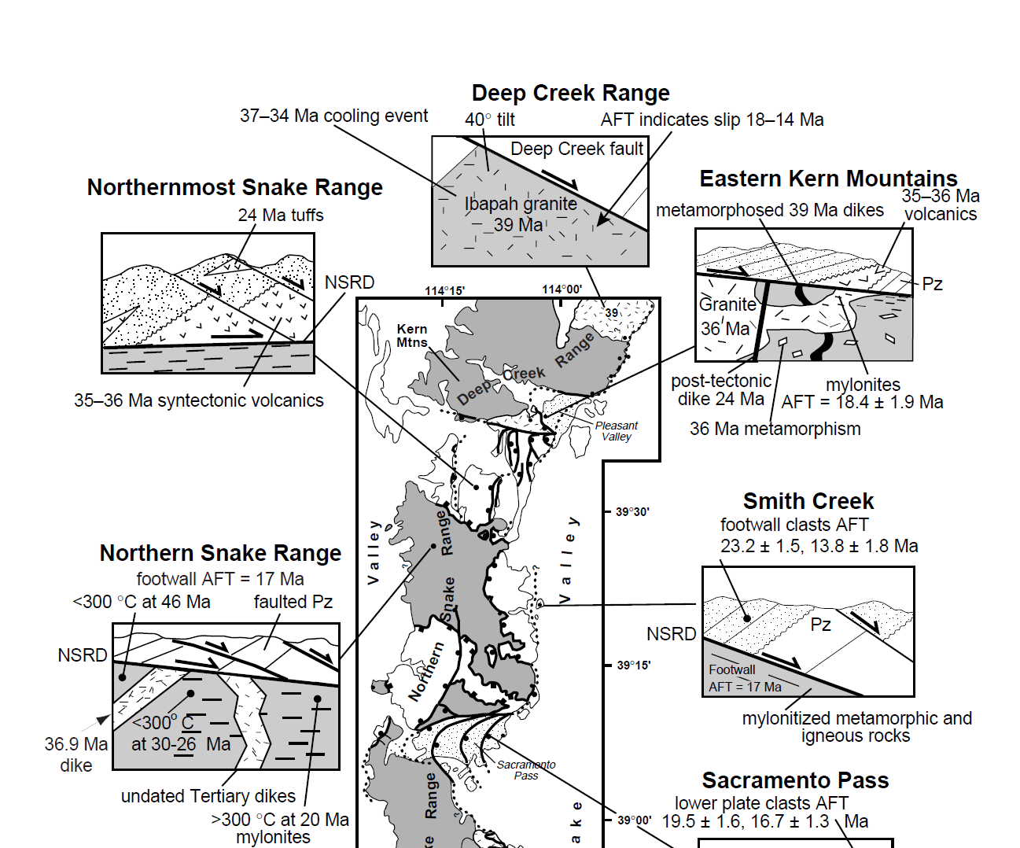
Northern Snake Range: Evidence for Two Events
In the northernmost Snake Range, sediments and volcanics (36Ma-24Ma) progressively have steeper dips with depth (15 to 40 deg) which is interpreted as a synextensional pattern.
Apatite on the eastern edge of the Scheel Creek Range yields ages similar to Northern Snake Range 15 Ma. However, zircon ages are much older indicating that the Schell Creek range was at lower temperatures than the Snake.
K-Ar and Ar-Ar ages mimic the strain gradient with older ages (60 Ma) in the west and younger ages (20 Ma) in the east
Different interpretations on the ages but agreement that the eastern ages reflect recent unroofing
The western edge had cooled to 300 deg C by 46 Ma
The eastern edge had cooled to 300 deg C by 20 Ma
The rhyolites mentioned on the previous slide

Slide 9
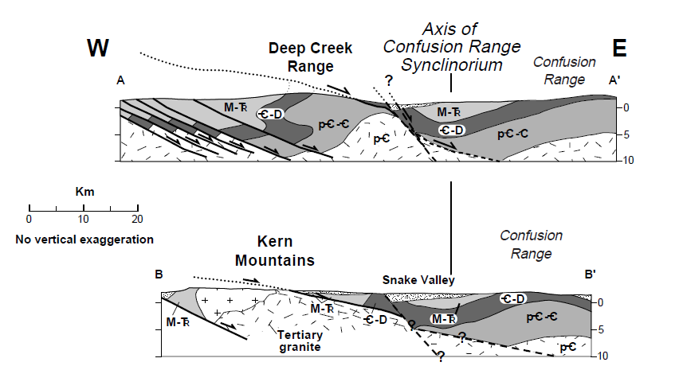
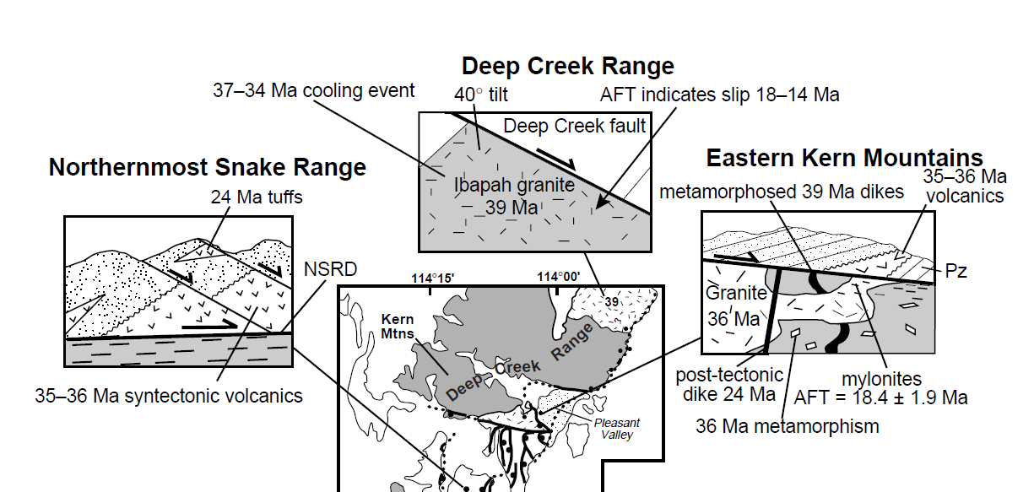
Kern Mountains and Deep Creek Range
The Skinner granite was intruded ~35 Ma
Border phases and related metamorphism are overprinted by mylonitic fabrics
Apatite and zircons support two discrete ages of fault slip
One event from 37-34 Ma coinciding with the intrusion of the Skinner granite
One event from 18-14 Ma
A minimum of 12km of slip between the two is interpreted based on crosscut Eocene volcanics

Slide 10
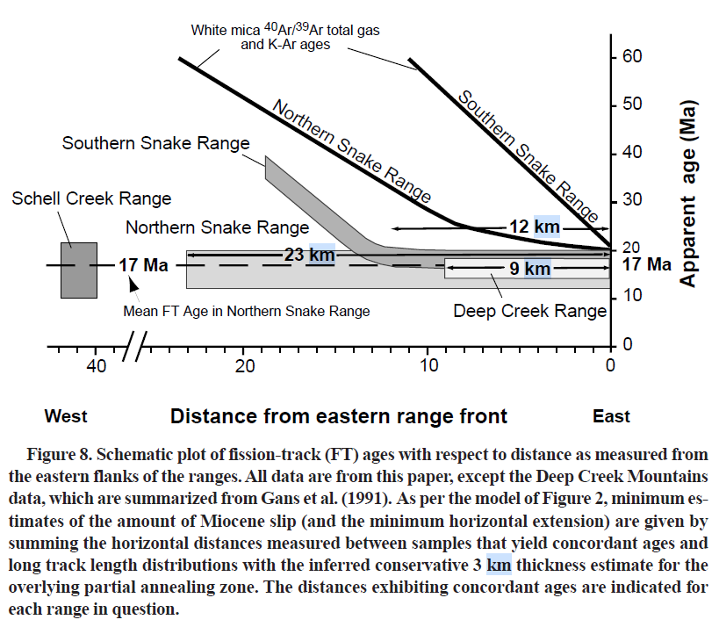
Summary: Age and Extension
A well-documented rapid slip event around 17Ma
Resulting in displacement amounts from 9km to 23km
An earlier event from 39-35 Ma supported by stratigraphic relationships, Ar data, select zircons, and data from the Deep Creek Mountains
This early event is interpreted to be influential for the western and northern portions of the ranges and is potentially obscured on the east by the younger event
This figure doesn’t account for the extended area above the partially annealing zone (12km for SSR instead of 15, and 9 instead of 12 for Deep Creek Range)

Slide 11
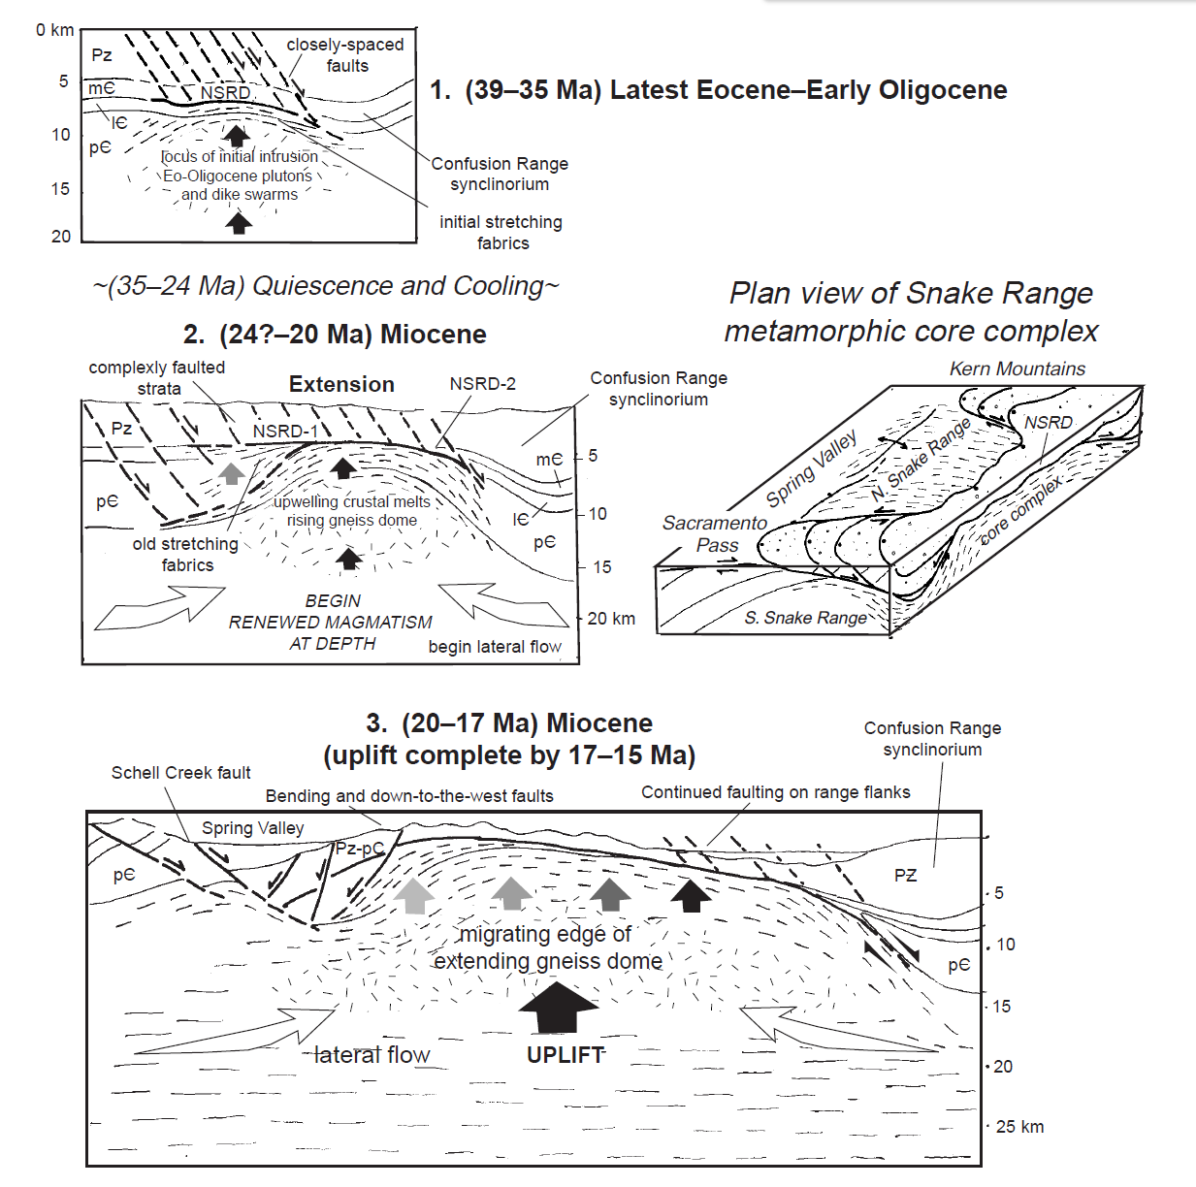
Model
They introduce their model by describing the history of structural interpretations of core complexes
An early idea (1983) is that detachment faults are rotated normal faults with high-amounts of displacement.
Miller et al argue that evidence in the Snake Range precludes this (lack of tilting, large amounts of ductile flow in the foot wall)
Low-angle detachment models have been criticized because there is lack of modern-day earthquake measurements and because low-angle normal faults are mechanically problematic without “free space”.
Model Steps:
Thickened crust is heated by Eocene to Oligocene plutons deep in the crust
The rising welt causes rocks to slide off the sides with extensional faults forming above it
The core would be the northern Snake Range
Other models suggest that core complexes are the result of extensional faulting. In contrast, this model emphasizes a rising dome of high-temperature, ductile rocks

